Slide 1
http://www.vidyanidhi.com/
ketkiacharya.net@gmail.com
Ketki Acharya
From: SM VITA ATC of CDAC
9769201036
ketkiacharya.net@gmail.com

Slide 2
What is jQuery
jQuery is a fast, lightweight, and feature-rich JavaScript library that is based on the principle "write less, do more".
jQuery was originally created by John Resig in early 2006. The jQuery project is currently run and maintained by a distributed group of developers as an open-source project.
Advantages of Using jQuery
What You Can Do with jQuery
Save lots of time — You can save lots of time and efforts by using the jQuery inbuilt effects and selectors and concentrate on other development work.
Simplify common JavaScript tasks — jQuery considerably simplifies the common JavaScript tasks. Now you can easily create feature rich and interactive web pages with fewer lines of codes, a typical example is implementing Ajax to update the content of a page without refreshing it.
Easy to use — jQuery is very easy to use. Anybody with the basic working knowledge of HTML, CSS and JavaScript can start development with jQuery.
Compatible with browsers — jQuery is created with modern browsers in mind and it is compatible with all major modern browsers such as Chrome, Firefox, Safari, Internet Explorer, etc.
Absolutely Free — And the best part is, it is completely free to download and use.
You can easily select elements to perform manipulation.
You can easily create effect like show or hide elements, sliding transition, and so on.
You can easily create complex CSS animation with fewer lines of code.
You can easily manipulate DOM elements and their attributes.
You can easily implement Ajax to enable asynchronous data exchange between client and server.
You can easily traverse all around the DOM tree to locate any element.
You can easily perform multiple actions on an element with a single line of code.
You can easily get or set dimensions of the HTML elements.

Slide 3
Downloading jQuery
To get started, first download a copy of jQuery and include it in your document.
There are two versions of jQuery available for downloading — compressed and uncompressed.
The uncompressed file is best suited for development or debugging; while, the minified and compressed file is recommended for production because it saves the precious bandwidth and improves the performance due to small file size.
You can download jQuery from here: https://jquery.com/download/
Once you've downloaded the jQuery file you can see it has .js extension, because the jQuery is just a JavaScript library, therefore you can include the jQuery file in your HTML document with the <script> element just like you include normal JavaScript files.
<script src="js/jquery-3.5.1.min.js"></script>
Including jQuery from CDN
Alternatively, you can include jQuery in your document through freely available CDN (Content Delivery Network) links, if you don't want to download and host jQuery yourself.
CDNs can offer a performance benefit by reducing the loading time, because they are hosting jQuery on multiple servers spread across the globe and when a user requests the file, it will be served from the server nearest to them.
This also offers an advantage that if the visitor to your webpage has already downloaded a copy of jQuery from the same CDN while visiting other sites, it won't have to be re-downloaded since it is already there in the browser's cache.
script src="https://code.jquery.com/jquery-3.5.1.min.js"></script>

Slide 4
Demo1: Using CDN
<!DOCTYPE html>
<html>
<head>
<script src="https://ajax.googleapis.com/ajax/libs/jquery/3.5.1/jquery.min.js"></script>
<script>
$(document).ready(function(){
$("#btn").click(function(){
$("#test").hide();
});
});
</script></head><body>
<p id="test">This is another paragraph.</p>
<button id="btn">Click me</button>
</body></html>
01_css_addclass.html:11 Uncaught ReferenceError: $ is not defined at 01_css_addclass.html:11
You will get this error if it can not find jQuery file.
Here we are selecting button using id, on click is event attached with button btn.
Observe anonymous function is passed in click method call.
$(document).ready() method ensure that all node get loaded then only it will execute further.
function(){
$("#btn").click()
}
function(){
$("#test").hide();
}
Hide will hide the p tag having id #test

Slide 5
Some selectors
Syntax | Description
$("*") | Selects all elements
$(this) | Selects the current HTML element
$("p.intro") | Selects all <p> elements with class="intro"
$("p:first") | Selects the first <p> element
$("ul li:first") | Selects the first <li> element of the first <ul>
$("ul li:first-child") | Selects the first <li> element of every <ul>
$("[href]") | Selects all elements with an href attribute
$("a[target='_blank']") | Selects all <a> elements with a target attribute value equal to "_blank"
$("a[target!='_blank']") | Selects all <a> elements with a target attribute value NOT equal to "_blank"
$(":button") | Selects all <button> elements and <input> elements of type="button"
$("tr:even") | Selects all even <tr> elements
$("tr:odd") | Selects all odd <tr> elements

Slide 6
The Document Ready Event
This is to prevent any jQuery code from running before the document is finished loading (is ready).
It is good practice to wait for the document to be fully loaded and ready before working with it. This also allows you to have your JavaScript code before the body of your document, in the head section.
$(document).ready(function(){ // jQuery methods go here... });
$(function(){ // jQuery methods go here... });
Tip: The jQuery team has also created an even shorter method for the document ready event:
<!DOCTYPE html>
<html><head>
<script src="jquery-1.9.1.js"></script>
<script>
alert(jQuery("p").length);
</script>
</head><body>
<p>para 1</p>
<p>para 2</p>
<p>para 3</p>
</body></html>
Alert will display 0. why??
Because
<script>
alert(jQuery("p").length);
</script>
this code executed before the p tag got loaded.
jQuery
And
$
Both are same ie. aliases to each othe

Slide 7
What if you wish to use other frameworks on your pages, while still using jQuery?
As you already know; jQuery uses the $ sign as a shortcut for jQuery.
There are many other popular JavaScript frameworks like: Angular, Backbone, Ember, Knockout, and more.
What if other JavaScript frameworks also use the $ sign as a shortcut?
If two different frameworks are using the same shortcut, one of them might stop working.
The jQuery team have already thought about this, and implemented the noConflict() method.
The noConflict() method releases the hold on the $ shortcut identifier, so that other scripts can use it.
<!DOCTYPE html>
<html><head>
<script src="https://ajax.googleapis.com/ajax/libs/jquery/3.5.1/jquery.min.js"></script>
<script>
$.noConflict();
$(document).ready(function(){
$("button").click(function(){
$("p").text("jQuery is not working!");
});
});
</script></head><body>
<p id="test">This is another paragraph.</p>
<button id="btn">Click me</button>
</body></html>
This code will not work as
$.noConflict();
Method has release the $ ie. $ is nolonger referring to jQuery.
How to solve problem ??

Slide 8
Use jQuery without $ sign
<script>
$.noConflict();
jQuery(document).ready(function(){
jQuery("button").click(function(){
jQuery("p").text("jQuery is still working!");
});
});
</script>
You can also create your own shortcut very easily. The noConflict() method returns a reference to jQuery, that you can save in a variable, for later use. Here is an example:
var jq = $.noConflict(); jq(document).ready(function(){ jq("button").click(function(){ jq("p").text("jQuery is still working!"); }); });
If you have a block of jQuery code which uses the $ shortcut and you do not want to change it all, you can pass the $ sign in as a parameter to the ready method. This allows you to access jQuery using $, inside this function - outside of it, you will have to use "jQuery":
Best way to have self invoking function and passjQuery
$.noConflict();
(function($){
$(document).ready(function(){
$("button").click(function(){
$("p").text("jQuery is still working!");
});
});
}(jQuery))
$.noConflict(); jQuery(document).ready(function($){ $("button").click(function(){ $("p").text("jQuery is still working!"); }); });

Slide 9
Function ready(myfunction)
{
Myfunction(jQuery)
}
$.noConflict(); jQuery(document).ready(function($){ $("button").click(function(){ $("p").text("jQuery is still working!"); }); });
jQuery(document).ready();
function($){ $("button").click(function(){ $("p").text("jQuery is still working!"); }); }

Slide 10
jQuery Getters & Setter for text/innerText
//Set
<!DOCTYPE html>
<html>
<head><style>
#dd{color:green;}
</style>
<script src="../jquery-1.9.1.js"></script>
<script>
$(document).ready(function() {
let p=$("#dd");
p.mouseover(function(){
p.text("<b>I have set value</b>");
});
});
</script>
</head><body>
<p id="dd">para 1</p>
</body></html>
//Get
<!DOCTYPE html>
<html><head><style>#dd{color:green;}
</style>
<script src="../jquery-1.9.1.js"></script>
<script>
$(document).ready(function() {
let p=$("#dd");
p.click(function(){
var a=p.text();
alert(a); })
});
</script></head><body>
<p id="dd">para 1</p>
<p>div para 1</p>
<p>div para 2</p>
</body></html>
text();➔ Get
text("<b>I have set value</b>");➔ Set

Slide 11
jQuery Getters & Setter for html/innerHTML
//Set
<!DOCTYPE html>
<html>
<head><style>
#dd{color:green;}
</style>
<script src="../jquery-1.9.1.js"></script>
<script>
$(document).ready(function() {
let p=$("#dd");
p.mouseover(function(){
$("#dd").html("<b>I have set value</b>");
});
});
</script>
</head><body>
<p id="dd">para 1</p>
</body></html>
//Get
<!DOCTYPE html>
<html><head><style>#dd{color:green;}
</style>
<script src="../jquery-1.9.1.js"></script>
<script>
$(document).ready(function() {
let p=$("#dd");
p.click(function(){
var a=p.html();
alert(a); })
});
</script></head><body>
<p id="dd">para 1</p>
<p>div para 1</p>
<p>div para 2</p>
</body></html>
html();➔ Get
html("<b>I have set value</b>");➔ Set

Slide 12
Difference between text and html
Setter method of text can not under stand tag , it will read text("<b>I have set value</b>"); <b> tag as text and get printed in browser as text
Setter method of html can understand tag. It will read
html("<b>I have set value</b>") <b> tag as tag and will give effect in browser.
$("p").html(); if you have 5 p tag on a page it will select 1st p tag.[querSelector]
$("p").html(“Replace”); if you have 5 p tag on a page it set value for all p tag. [querSelectorAll]
=$(“p").text(); if you have 5 p tag on a page it will select all p tag.[querSelectorAll]
$("p"). text(“Replace”); if you have 5 p tag on a page it set value for all p tag. [querSelectorAll]
The jQuery text() retrieves the values of all the selected elements (i.e. combined text), whereas the other getters such as html(), attr(), and val() returns the value only from the first element in the selection.

Slide 13
attr()➔ getter setter getAttribute(“align”) setAttribute(“align”,”center”)
<!DOCTYPE html>
<html><head><script src="../jquery-1.9.1.js"></script>
<script>
$(document).ready(function() {
let a=$("#aa");
a.mouseover(function(){
a.attr("align","center");
});
let a2=$("#nn");
a2.mouseover(function(){
a2.attr({ "align":"center",
"title":"go"} ) });
});
</script></head><body>
<h1 id="aa" align="right"/>Hello</h1>
<h3 id="nn"/>h3</h3> </body></html>
//Get
<!DOCTYPE html>
<html>
<head<script src="jquery-1.9.1.js"></script>
<script>
$(document).ready(function() {
var b=$("#aa").attr("href");
alert(b);
});
</script>
</head><body>
<a href="01.html" id="aa"/>click</a>
<a href="01.html" id="nn" alt="open file 01"/>
click</a>
</body></html>
attr(‘align’);➔ Get value for align attribute
attr("align","center")➔ Set value for align attribute
attr({ "align":"center","title":"go"} )➔allow you to set multiple attribut;’s value

Slide 14
prop()➔ getter setter
<!DOCTYPE html>
<html><head>
<script src="../jquery-1.9.1.js"></script>
<script>
$(document).ready(function() {
var b="";
$("#btn").click(function()
{
let r=$('#rd1');
r.prop('checked’, true)
});
});
</script>
</head><body><pre>
<form id="frm" action="a.html">
<input id="rd1" type="radio" name="ch" value="+"/>+
<input id="rd2" type="radio" name="ch" value="-"/>-
<input type="button" id="btn" value="checked r1"/>
</form></pre>
<div id="DD">dd</div>
</body></html>
//Get
<!DOCTYPE html>
<html><head>
<script src="../jquery-1.9.1.js"></script>
<script>
$(document).ready(function() {
var b="";
$("#btn").click(function()
{let r=$('#rd1');
let result=r.prop('checked')
$("#DD").text(result);
});
});
</script></head>
<body><pre>
<form id="frm" action="a.html">
<input id="rd1" type="radio" name="ch" value="+"/>+
<input id="rd2" type="radio" name="ch" value="-"/>-
<input type="button" id="btn" value="get data"/>
</form></pre>
<div id="DD">dd</div>
</body></html>
prop('checked') ➔ Get value for checked property
prop('checked’,true) ➔ Set value for checked property

Slide 15
Create h1 tag and type your name
create a button on click
name in h1 tag should be replace with data "welcome to CDAC"
<h1> Ketki</h1> welcome to CDAC
[button ]

Slide 16
val()➔ getter setter
<!DOCTYPE html>
<html><head>
<script src="jquery-1.9.1.js"></script>
<script>
$(document).ready(function() {
$("#btn").click( function(){
var a=$("#t1").val();
$("#t2").val(a)})
});
</script>
</head><body>
<input type="text" value="my data" id="t1"/>
<input type="button" value="copy" id="btn"/>
<input type="text" id="t2"/>
</body></html>
val() ➔ Get value for textbox, checkbox, radio and select
val(“set value”) ➔ Set value for textbox, checkbox, radio and select

Slide 17
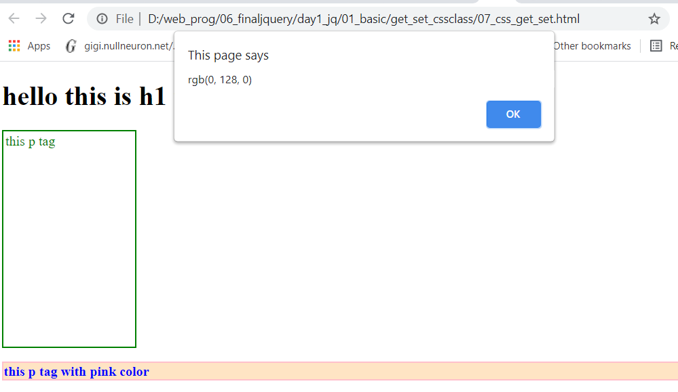
<script>
$(document).ready(function() {
$("#pd").mouseover(function ()
{
var a=$("#pd").css("color");
alert(a);
$("#s").css("color","blue");
$("#s").css({'background-color':'bisque','font-weight' : 'bolder'});
});
});
</script>
</head><body>
<h1> hello this is h1 tag</h1>
<p id="pd" class="gc"> this p tag</p>
<p id="s" class="rc"> this p tag with pink color</p>
</body>
</html>
<!DOCTYPE html>
<html><head><style>
.rc {color:pink;
border:2px solid pink;
}
.gc { color:green;
height:250px;
border:2px solid green;
padding:2px;
width:150px;
}
</style>
<script src="../jquery-1.9.1.js"></script>

Slide 18
CSS➔addClass-removeClass- toggle
<!DOCTYPE html>
<html>
<head><style>
.gc {color:green;}
</style>
<script src="jquery-1.9.1.js">
</script><script>
$(document).ready(function() {
$("#pd").mouseover(function() {
$("#pd").toggleClass("gc");
})
});
</script></head>
<body>
<p id="pd" class="gc"> this p tag</p>
</body></html>
<!DOCTYPE html>
<html>
<head><style>
.rc {color:pink;}
</style>
<script src="../jquery-1.9.1.js"> </script>
<script>
$(document).ready(function() {
$("#pd").mouseover(function (){
$("#pd").addClass("rc");
})
});
</script>
</head><body>
<p id="pd"> this p tag</p>
</body></html>
Onmouseover this p tag
<!DOCTYPE html>
<html>
<head><style>
.rc {color:pink;}
</style>
<script src="jquery-1.9.1.js"></script>
<script>
$(document).ready(function() {
$("#pd").mouseover(function (){
$("#pd").removeClass("rc");
})
});
</script></head>
<body>
<p id="pd" class="rc"> this p tag</p>
</body>
</html>
Onmouseover this p tag will remove .rc this p tag and if you again do mouseover it will become
this p tag
Onmouseover this p tag will remove .rc this p tag

